Slide 1

INSTITUTE UIE
DEPARTMENT ACADEMIC UNIT-1
Bachelor of Engineering (Computer Science & Engineering)
Subject Name Semi Conductor Physics
Subject Code 23SPH-143
Prepared By
Navjeet Kaur
Experiment-2.1.4
Emitter efficiency and Transport factor.
DISCOVER . LEARN . EMPOWER

Slide 2
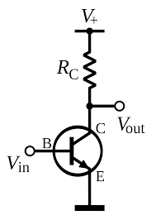
Lecture Objectives
S. No. | Objectives
1 | To make student aware about the basic concept of CE configuration.
2 | To aware about working of CE configuration.
3 | To provide knowledge about input and output characteristic of CE configuration
4 | To make familiar with formation of depletion zone
5 | To give brief knowledge about depletion layer
Source:https://upload.wikimedia.org/wikipedia/commons/thumb/a/a0/NPN_common_emitter.svg/1200px-NPN_common_emitter.svg.png /

Slide 3
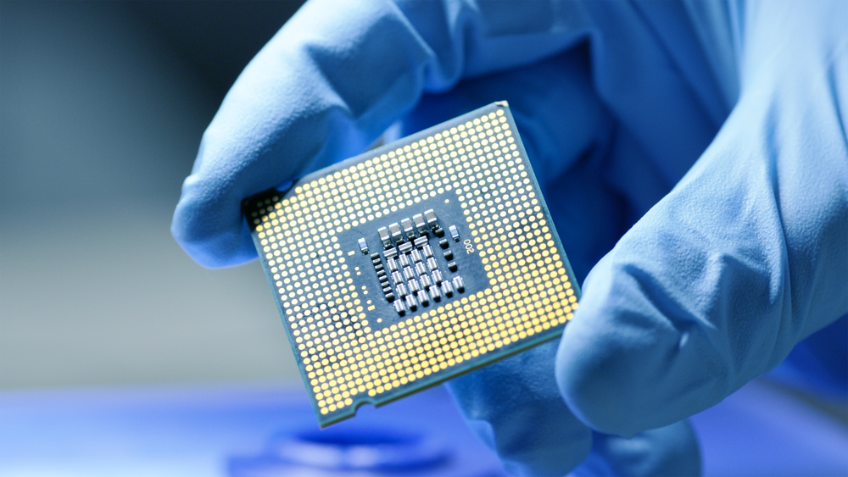
Course Objectives
S. No. | Objectives
1 | To understand the basic materials and properties of semiconductors.
2 | Understand the basic of semiconductor and components like diode, transistor, FET, MOSFET and Energy Sources.
3 | To give knowledge about semiconductor physics and discus working and applications of basic devices, including p-n junctions, BJTs and FETs.
https://www.iqsdirectory.com/resources/everything-you-ever-wanted-to-know-about-semiconductors/

Slide 4

Course Outcomes
S.NO | Description | Blooms’ Taxonomy Level
CO1 | To apply the knowledge of basic semiconductor material physics and understand fabrication processes. | EASY
CO2 | To understand the characteristics of different electronic devices such as diodes, transistors. | MEDIUM
CO3 | To derive the relationships between the parameters in diode, FET, configurations of Transistor and MOSFETs. | MEDIUM
CO4 | To describe the working and design considerations for the various photonic devices like photo detectors, solar-cells and LEDs. | HARD
CO5 | To provide problem solving experience and learning of concepts through it in semiconductor physics. | HARD
https://lot.dhl.com/5-things-the-current-semiconductor-slowdown-tells-us-about-the-global-economy/

Slide 5
Content
Common Emitter Configuration
Input characteristics
Output characteristics
Advantages & applications
Injection efficiency
Tansport factor

Slide 6
Common Emitter Configuration
In common emitter configuration, base is the input terminal, collector is the output terminal and emitter is the common terminal for both input and output. That means the base terminal and common emitter terminal are known as input terminals whereas collector terminal and common emitter terminal are known as output terminals.
In common emitter configuration, the emitter terminal is grounded so the common emitter configuration is also known as grounded emitter configuration. Sometimes common emitter configuration is also referred to as CE configuration, common emitter amplifier, or CE amplifier. The common emitter (CE) configuration is the most widely used transistor configuration.

Slide 7
Common Emitter Configuration
Fig-1 common emitter configuration
Source:https://www.physics-and-radio-electronics.com/electronic-devices-and-circuits/transistors/bipolarjunctiontransistor/images/commonemitterconfiguration.png
Notes:
Source:https://www.physics-and-radio-electronics.com/electronic-devices-and-circuits/transistors/bipolarjunctiontransistor/images/commonemitterconfiguration.png

Slide 8
Common Emitter Configuration
The common emitter (CE) amplifiers are used when large current gain is needed.
The input signal is applied between the base and emitter terminals while the output signal is taken between the collector and emitter terminals. Thus, the emitter terminal of a transistor is common for both input and output and hence it is named as common emitter configuration.
The supply voltage between base and emitter is denoted by V_{BE} while the supply voltage between collector and emitter is denoted by V_{CE}.

Slide 9
Common Emitter Configuration
In common emitter (CE) configuration, input current or base current is denoted by I_{B} and output current or collector current is denoted by I_{C.}
The common emitter amplifier has medium input and output impedance levels. So the current gain and voltage gain of the common emitter amplifier is medium. However, the power gain is high.
To fully describe the behavior of a transistor with CE configuration, we need two set of characteristics – input characteristics and output characteristics.

Slide 10
Input characteristics
The input characteristics describe the relationship between input current or base current (I_{B}) and input voltage or base-emitter voltage (V_{BE}).
First, draw a vertical line and a horizontal line. The vertical line represents y-axis and horizontal line represents x-axis. The input current or base current (I_{B}) is taken along y-axis (vertical line) and the input voltage (V_{BE}) is taken along x-axis (horizontal line).
To determine the input characteristics, the output voltage V_{CE} is kept constant at zero volts and the input voltage V_{BE} is increased from zero volts to different voltage levels. For each voltage level of input voltage (V_{BE}), the corresponding input current (I_{B}) is recorded.

Slide 11
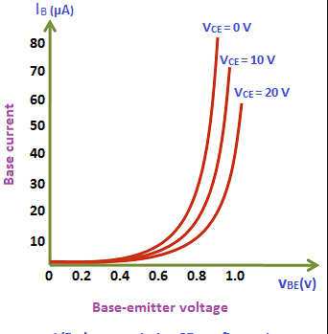
Input characteristics
Fig-2 input chaacteristics
Source:https://qph.fs.quoracdn.net/main-qimg-0472d889e300e0e4fa01a557f19c2243
.

Slide 12
Input characteristics
A curve is then drawn between input current I_{B} and input voltage V_{BE} at constant output voltage V_{CE} (0 volts).
Next, the output voltage (V_{CE}) is increased from zero volts to certain voltage level (10 volts) and the output voltage (V_{CE}) is kept constant at 10 volts. While increasing the output voltage (V_{CE}), the input voltage (V_{BE}) is kept constant at zero volts. After we kept the output voltage (V_{CE}) constant at 10 volts, the input voltage V_{BE} is increased from zero volts to different voltage levels. For each voltage level of input voltage (V_{BE}), the corresponding input current (I_{B}) is recorded.
A curve is then drawn between input current I_{B} and input voltage V_{BE} at constant output voltage V_{CE} (10 volts).

Slide 13
Input characteristics
This process is repeated for higher fixed values of output voltage (V_{CE}).
When output voltage (V_{CE}) is at zero volts and emitter-base junction is forward biased by input voltage (V_{BE}), the emitter-base junction acts like a normal p-n junction diode. So the input characteristics of the CE configuration is same as the characteristics of a normal pn junction diode.
The cut in voltage of a silicon transistor is 0.7 volts and germanium transistor is 0.3 volts. In our case, it is a silicon transistor. So from the above graph, we can see that after 0.7 volts, a small increase in input voltage (V_{BE}) will rapidly increases the input current (I_{B}).

Slide 14
Input characteristics
In common emitter (CE) configuration, the input current (I_{B}) is very small as compared to the input current (I_{E}) in common base (CB) configuration. The input current in CE configuration is measured in microamperes (μA) whereas the input current in CB configuration is measured in milliamperes (mA).
In common emitter (CE) configuration, the input current (I_{B}) is produced in the base region which is lightly doped and has small width. So the base region produces only a small input current (I_{B}). On the other hand, in common base (CB) configuration, the input current (I_{E}) is produced in the emitter region which is heavily doped and has large width. So the emitter region produces a large input current (I_{E}). Therefore, the input current (I_{B}) produced in the common emitter (CE) configuration is small as compared to the common base (CB) configuration.

Slide 15
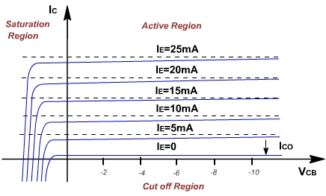
Output characteristics
Fig-3 Output characteristics
Source:https://i.stack.imgur.com/49eBH.jpg
Notes:
Source:https://i.stack.imgur.com/49eBH.jpg

Slide 16
Injection efficicency
A curve is then drawn between output current I_{C} and output voltage V_{CE} at constant input current I_{B} (0 μA).
When the base current or input current I_{B} = 0 μA, the transistor operates in the cut-off region. In this region, both junctions are reverse biased.
Next, the input current (I_{B}) is increased from 0 μA to 20 μA by adjusting the input voltage (V_{BE}). The input current (I_{B}) is kept constant at 20 μA.
While increasing the input current (I_{B}), the output voltage (V_{CE}) is kept constant at 0 volts.
After we kept the input current (I_{B}) constant at 20 μA, the output voltage (V_{CE}) is increased from zero volts to different voltage levels. For each voltage level of output voltage (V_{CE}), the corresponding output current (I_{C}) is recorded.

Slide 17
Summary
Introduction to Common Emitter Configuration.
Block diagram of Input characteristics
Input characteristics AND Output characteristics.
Applications of Common Emitter Configuration.

Slide 18
Frequently Asked Questions
Explain Input characteristics?
Explain Output characteristics?

Slide 19

LEARNING OUTCOMES
To make students understand
Concepts of CE configuration
Concepts of Input characteristics
Concepts of Output characteristics.

Slide 20
References
Text Books:
Microelectronics Circuits, Adel S. Sedra and Kenneth Carless Smith, Oxford University Press.
Millman’s Integrated Electronics, Jacob Millman, Christos Halkias, Chetan Parikh, McGraw Hill Education.
Digital Logic & Computer Design, M. Morris Mano, Pearson
Reference Books:
Principles of Electronics, V K Mehta , Rohit Mehta, 12/e , S. Chand Publishing
Solid State Electronic Devices,6th Edition, Ben Streetman, Sanjay Banerjee
Electronic Principle, Albert Paul Malvino.
Electronics Circuits:Discrete & Integrated, D Schilling C BeloveTApelewiczRSaccardi.
Microelectronics, Jacob Millman, Arvin Grabel.
Electronics Devices &Circuits,S. Salivahanan, N. Suresh Kumar,A. Vallavaraj
Electronic Devices & Circuit Theory, 11th Edition, Robert L. Boylestad,LouisNashelsky

Slide 21
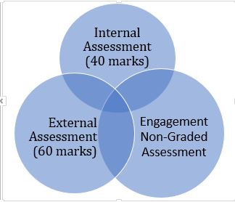
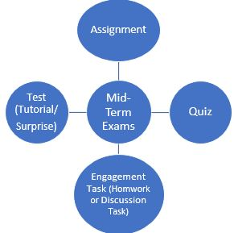
Assessment Pattern

